Slide 1
Protecting My Mind

Slide 2
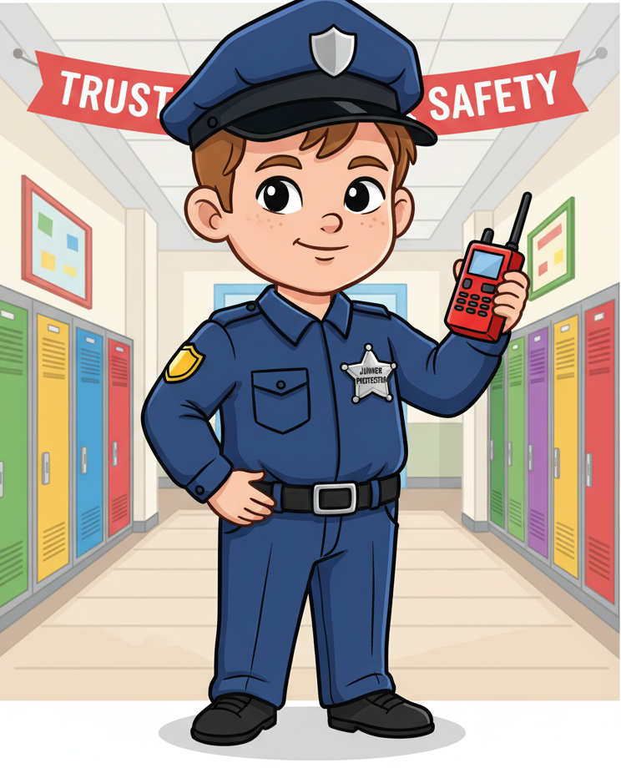

Slide 8
The Devil’s Poo

Slide 9
The Devil’s Poo

Slide 10
The Devil’s Poo

Slide 11
“And do not give the devil a foothold.” —Ephesians 4:27

Slide 12
“A person without self-control is like a city with broken-down walls.”
—Proverbs 25:28

Slide 13
People’s Words and Actions
Believing Lies
Pride
Bad Habits
Unforgiveness
Lying
Jealousy
Fear
Anger
Selfishness
Bad Attitude
Hatred

