Slide 1
Growing Strong Becoming Like Jesus

Slide 2
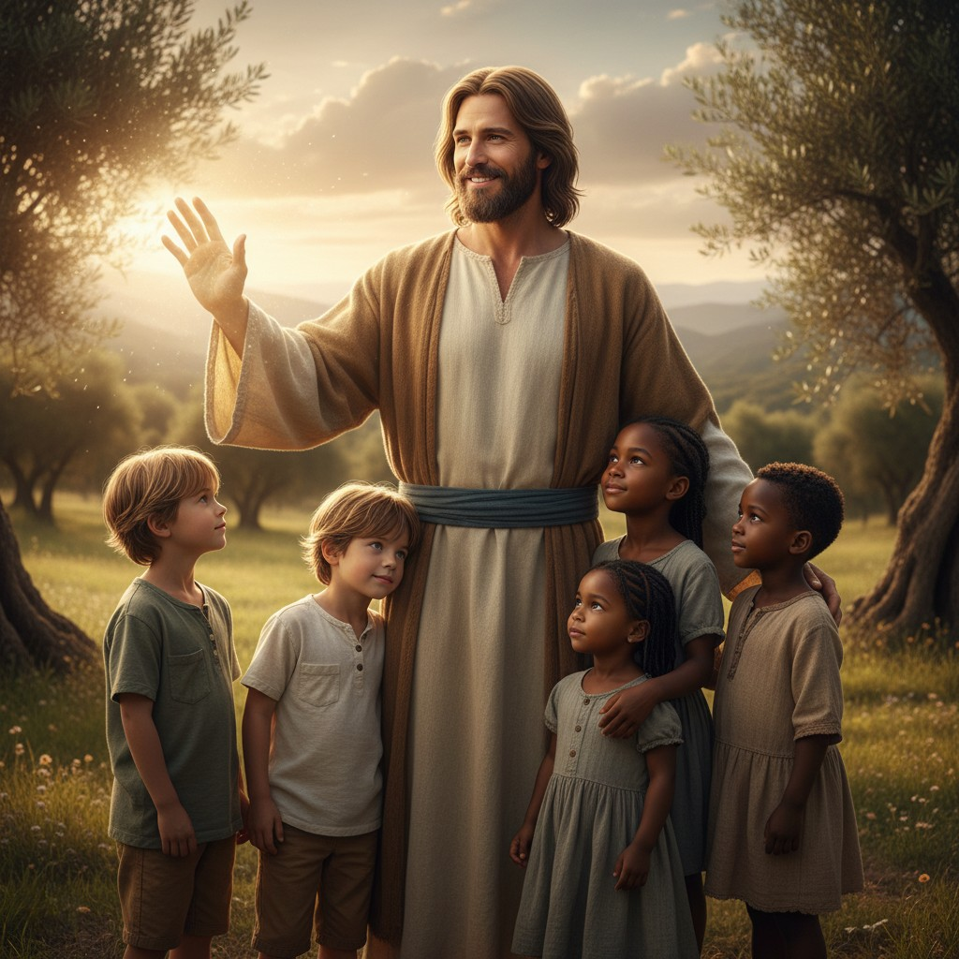
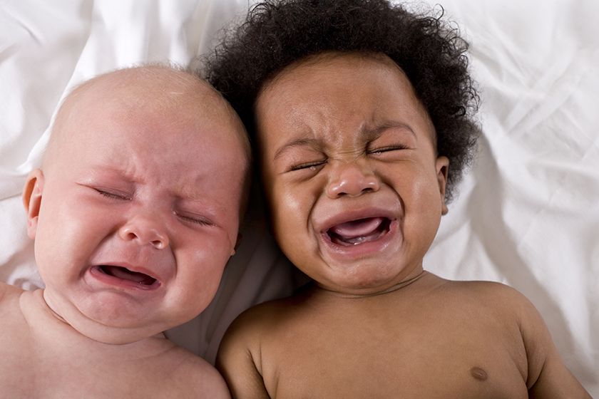
Growing to be like Jesus has ups and downs.

Slide 3
Sometimes growing is hard.
We help children over the hard parts.

Slide 4
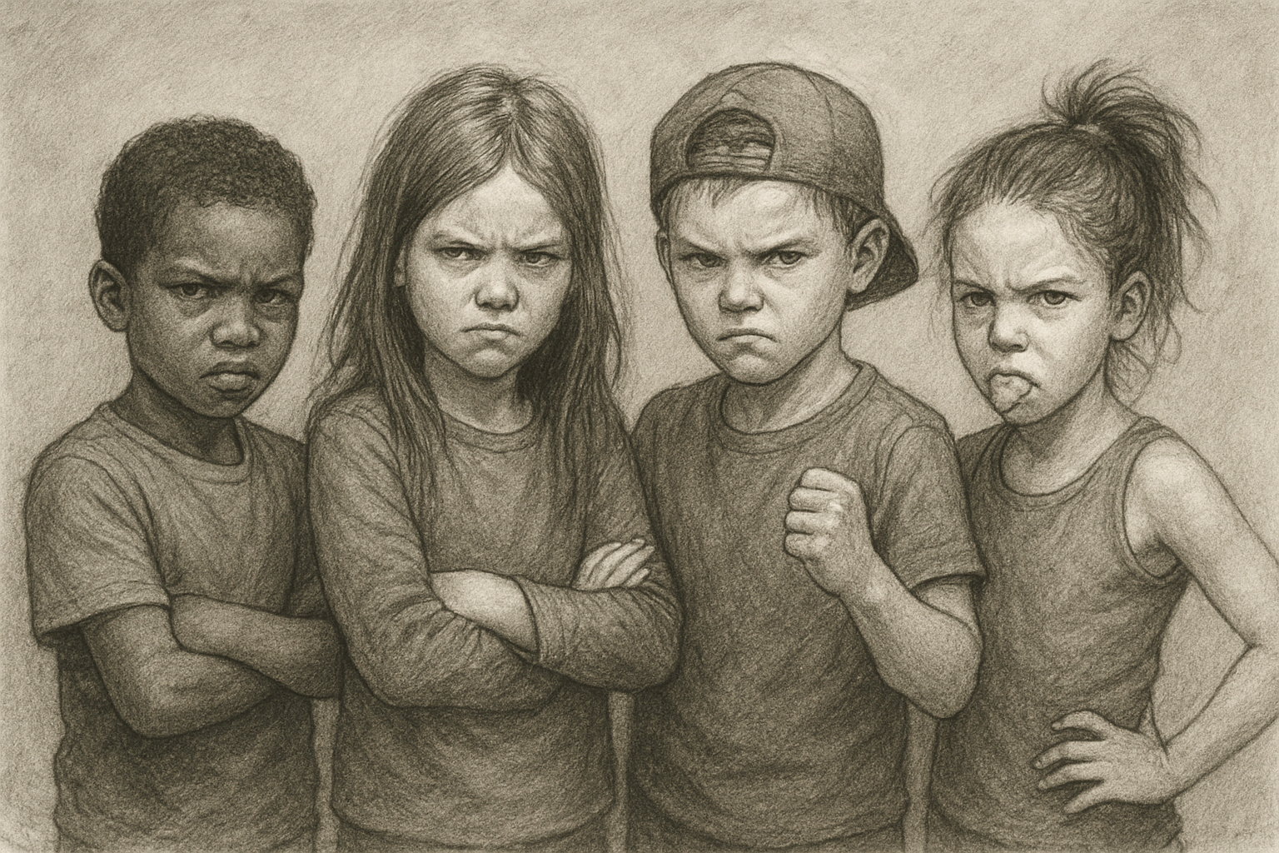
Growing strong is sometimes hard.
Some children stay angry and mean.

Slide 5

God pulls us up by giving us His strength.
God’s is Stronger
The Devil’s Strength

