Slide 1
I Can Win! I Have a Strong Mind

Slide 2
Unforgiveness
People’s Words and Actions
Lies We Believe
Temptation
Bad Habits
Fear
Notes:
Unhealed wounds could be included, but they could be categorized with #6, as there is often, and almost always a lie attached to wounds.

Slide 3
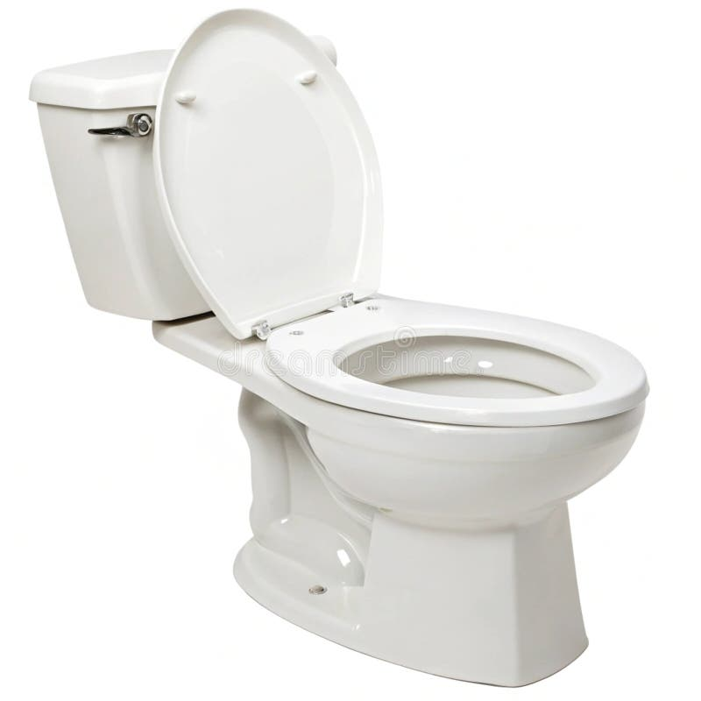
• Unforgiveness
• People’s Words and Actions
Your
Fight
The Devil’s
Poo
X
X
X
• Lies We Believe
• Temptations
• Bad Habits
• Fear
X
X
X
Your
Mind
The Devil wants
to go around
your faucet
Your decision to stop the Devil’s poo
Notes:
Unhealed wounds could be included, but they could be categorized with “Lies We Believe,” as there is often, and almost always a lie attached to wounds.

