Slide 1

Spiritual Development Becoming More Like Jesus

Slide 2
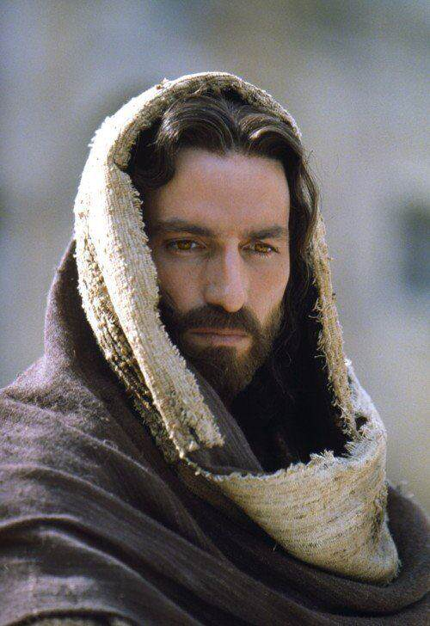
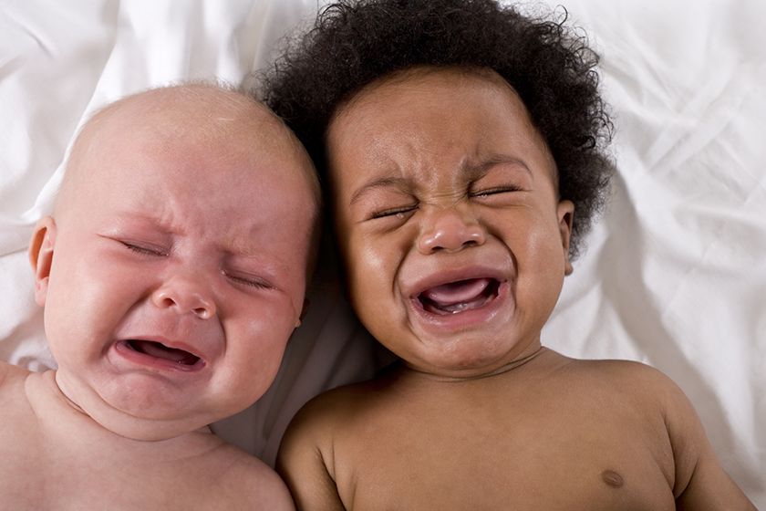
THE IDEAL:
Spiritual growth from infancy stage to
maturity.
Notes:
“And I am certain that God, who began the good work within you, will continue his work until it is finally finished on the day when Christ Jesus returns.”
Philippians 1:6 NLT

Slide 3
REALITY: Spiritual growth is a series of ups and downs.

Slide 4
DELIVERANCE
When a person has barriers to spiritual growth, deliverance can help them overcome those barriers.

Slide 5
For some, it is not a deliverance issue.
It is a discipline issue.
Most do not want to pay the price to grow, and the result is that they remain a spiritual infant.

Slide 6

God’s Magnetism
“For no one can come to me unless the Father who sent me draws them to me, and at the last day I will raise them up.”
(John 6:44 NLT)
Remain A Spiritual Infant
1. Human Nature
Magnetism
From
2. Demons
3. Sinful Culture

