Slide 1
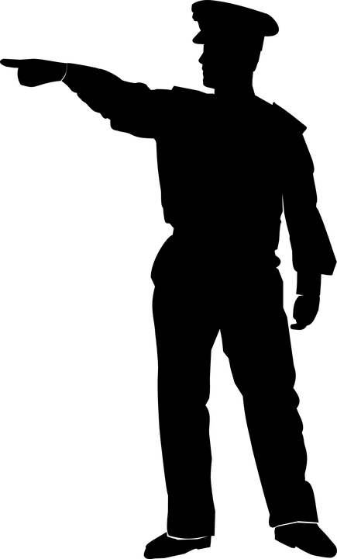


Slide 8


Slide 10
“And do not give the devil a foothold.” —Ephesians 4:27

Slide 11
“A person without self-control is like a city with broken-down walls.”
—Proverbs 25:28

Slide 12
Lust
Bad Habits
Greed
Deceit
Lies, about
God / Self
Opposition to Church Leaders
Unforgiveness
Jealousy
Sins
Emotional Wounds
Occult Practices
Fear
Soul Ties
Selfishness
Anger, Rage
Hatred
Negative Attitudes
Pride
Addictions

Slide 13
Strongholds can be a defensive mindset that sets itself up against God’s voice. It keeps the unhealed places of our hearts from being healed and sets us up for demonic oppression.
Notes:
Denial: refusing to face truth.
Victimization: blaming others/ “life isn’t fair”.
Rationalizing: making excuses
Isolation: withdraw to escape our reality
Projection: finger-pointing / condemning others
Addictions: searching for comfort in habits, and not from God

Slide 14
• Strongholds often begin with unhealed wounds, hurts, unconfessed sin.
• Satan uses those as a hook to keep us oppressed.
• Oppression can affect our physical bodies (pain in chest/ literal weight is felt).
Notes:
Denial: refusing to face truth.
Victimization: blaming others/ “life isn’t fair”.
Projection: finger-pointing / condemning others
Rationalizing: making excuses
Isolation: withdraw to escape our reality
Addictions: searching for comfort in habits, and not from God

Slide 15
Demolishing Strongholds
1. Identify the defensive mindset (pray and ask God what, if any, strongholds are in your life).

Slide 16
Demolishing Strongholds
2. Decide to turn (repent) from any sin you have had as a result of that mindset.

Slide 17
Demolishing Strongholds
3. Declare that God alone is the only Stronghold we have in our lives. He is our only refuge and place of protection.

Slide 18
Demolishing Strongholds
4. Pray for God to demolish the ungodly stronghold.
—2 Corinthians 10:3-5

Slide 19
We are human, but we don’t wage war as humans do. We use God’s mighty weapons, not worldly weapons, to knock down the strongholds of human reasoning and to destroy false arguments. We destroy every proud obstacle that keeps people from knowing God. We capture their rebellious thoughts and teach them to obey Christ. —2 Corinthians 10:3-5

Slide 20
But you belong to God, my dear children. You have already won a victory over those people, because the Spirit who lives in you is greater than the spirit who lives in the world.
—1 John 4:4

