Slide 1
Unforgiveness
How it Affects a Christian

Slide 2
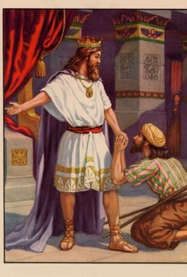
10,000 Talents
Impossible to Repay
If Gold: 7-11 Billion
If Silver: 161 Million
Notes:
King was owed 10,000 talents – the amount shows it was impossible to repay.
It would take 150,000 years or more on an average daily salary.

Slide 3
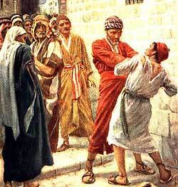
Unwilling to forgive a small debt—100 Denarii:
  Several thousand dollars
Matthew 18:21-35
The Parable of the Unforgiving Servant

Slide 4
Unforgiveness
In anger his master handed him over to the jailers to be tortured, until he should pay back all he owed. “This is how my heavenly Father will treat each of you unless you forgive your brother or sister from your heart.”
—Mt. 18:33-45

Slide 5
Bypassed for a Raise or Advancement
Because of Favoritism
Bully On the Playground
Teacher Embarrassed You
I
Demeaning Verbal Abuse
Mistreatment
by Current or Former Spouse
Parents Never Affirmed You
Sexual Abuse

Slide 6

Unforgiveness is like a wound that will not heal
Decaying Skin
Bacteria
Stench
Infectious / Poison
Pus

Slide 7
When Forgiveness is Not Given
Others smell the stench from the unhealed wound.
  The odor is so familiar it isn’t noticed by the person with the wound.
Infection spreads throughout the body (personality).
The germs and bacteria (bitterness) infects others.

Slide 8
The Goal
Healing of the soul that has been embittered by unforgiveness.

Slide 9
Forgiveness is not a process, it is a decision!

Slide 10
Unforgiveness is a Sin
  We do not gradually stop sinning.
  A murderer does not gradually stop killing people.

Slide 11
Bypassed for a Raise or Advancement
Because of Favoritism
Bully On the Playground
Teacher Embarrassed You
I
Demeaning Verbal Abuse
Mistreatment
by Current or Former Spouse
Parents Never Affirmed You
Sexual Abuse

